Slide 1

Note: The data and information in this document is reflective of a hypothetical situation and client. This document is to be used for KPMG Virtual Internship purposes only.
Sprocket Central Pty Ltd
Data analytics approach

Slide 2
Note: The data and information in this document is reflective of a hypothetical situation and client. This document is to be used for KPMG Virtual Internship purposes only.
Agenda
Introduction
Data Exploration
Model Development
Interpretation

Slide 3
Note: The data and information in this document is reflective of a hypothetical situation and client. This document is to be used for KPMG Virtual Internship purposes only.
Introduction
Variables to look at
Age
Job industry
Cars owned
Location

Slide 4
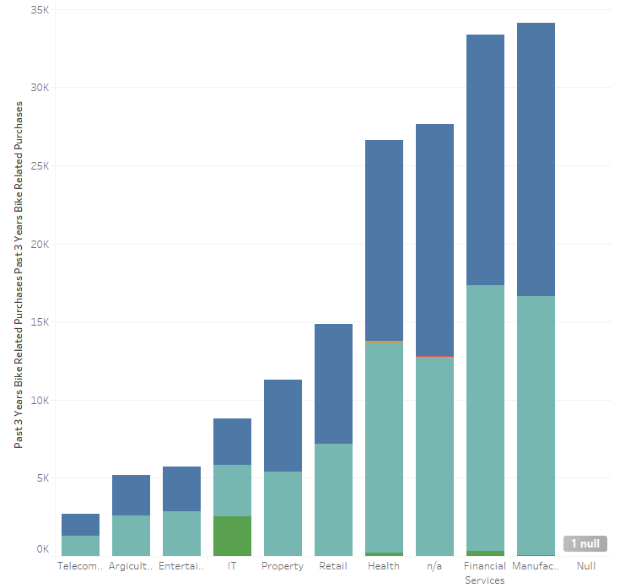
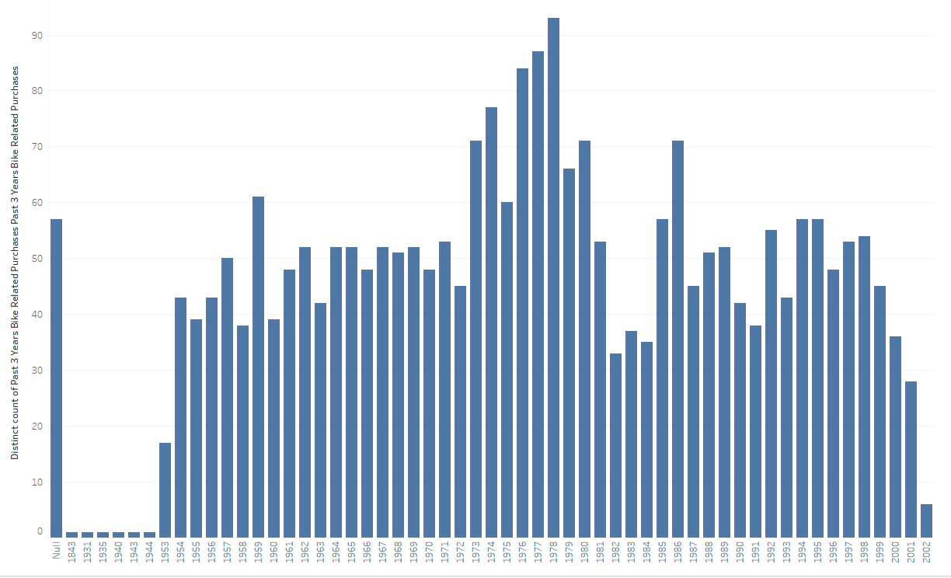
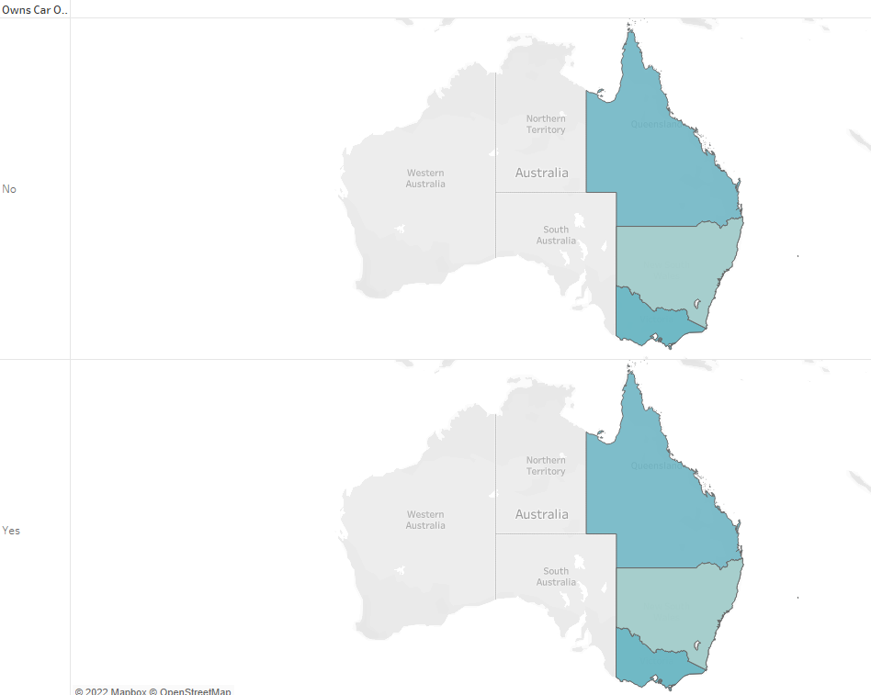
Note: The data and information in this document is reflective of a hypothetical situation and client. This document is to be used for KPMG Virtual Internship purposes only.
Data Exploration
Metrics and charts by the important variables

Slide 5
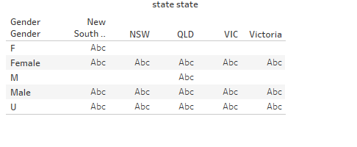
Note: The data and information in this document is reflective of a hypothetical situation and client. This document is to be used for KPMG Virtual Internship purposes only.
Model Development
Targeting customer
1. A lot of the customers are female buyers
2. They are in the health, financial and manufacturing job sector
3. Most of them New South Wales
4. Most of the female customers are in the age group of around 56

Slide 6
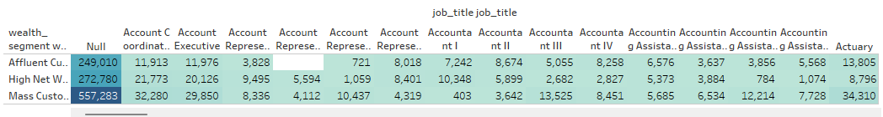
Note: The data and information in this document is reflective of a hypothetical situation and client. This document is to be used for KPMG Virtual Internship purposes only.
Interpretation
Count: 558
SUM(customer_id customer_id (CustomerDemographic))
Sum: 8,002,000
Average: 14,340.50
Minimum: 13
Maximum: 557,283
Median: 9,177.50
SUM(Past 3 Years Bike Related Purchases Past 3 Years Bike Related Purchases)
Sum: 195,560
Average: 350.47
Minimum: 0
Maximum: 11,893
Median: 228.50
Customer table

Slide 7
Note: The data and information in this document is reflective of a hypothetical situation and client. This document is to be used for KPMG Virtual Internship purposes only.
Thank you!

